Slide 1


TEAM BANANA YELLOW
https://github.com/Team-Banana-Yellow/TeamBananaYellow

Slide 2
Anna Tsarnakova
home, teachers, about us and contact page creation
Project publication and validation
Plamena Miteva
students and courses page creation
power point presentation creation
Delcho Dimitrov
fun page creation
Yoana Nikolova

Slide 3
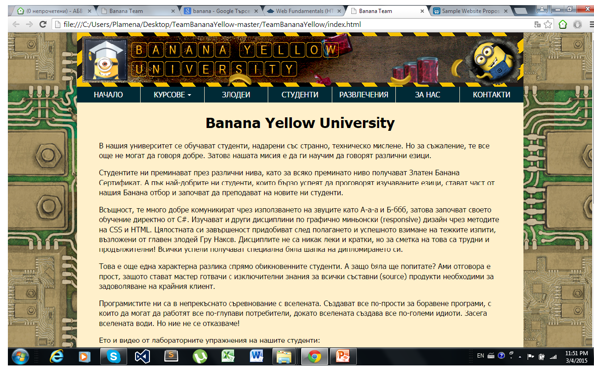
Visit us on: http://qts.zb5.net/TeamBananaYellow/index.html.bg

Slide 4
Site Map
Home Page – introduction to the university including an embedded video
Courses – describes the programming languages as super heroes
Villains – our trainers
Students – admission information
Fun – programmers funny stories
About us – information about the team and contact details

